Slide 1
Financial Calculations Package
Angelina Rabbia, Jordan Braycewski, Anith Joy, Vishal Sukumar

Slide 2
In the slides, please demonstrate the following components:
1. What problems can be solved by using your package.
2. Demonstrate the function you design and its functionality.
3. Demonstrate the robustness of your function. (e.g. the user may not know about the correct input data type and input weird other things, use try except to handle this situation.)
4. Apply your package on the dataset to show it works.
5. Draw the conclusions of your regression analysis.
6. Compare your conclusions with other groups, find out the different or common things.

Slide 3
Problems Solved
Our package allows access to functions in python for much quicker and easier calculations of present and future value of single sums and annuities as well as cash flow analysis, payback period and probability index
It provides a set of tools to perform various calculations and analyses crucial in financial planning, investment evaluation, and risk assessment
This package would be beneficial for financial professionals, analysts, as well as everyday investors
Notes:
Jordan

Slide 4
List of Functions
pv_one()
fv_one()
pv_ordinary_annuity()
fv_ordinary_annuity()
pv_annuity_due()
fv_annuity_due()
growing_annuity()
perpetuity()
growing_perpetuity()
annuity_payment()
cash_flow_analysis()
payback_period()
probability_index()
total_interest_paid()
total_payments()

Slide 5
Functionality

Slide 6
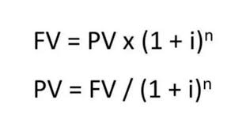
Present Value of a Single Sum
Description: Calculates the present value of a single sum based on the future value, interest rate, and periods entered by the user.
Formula:
Function:
pv_one(fv:float, rate:float, periods:float)->float
Notes:
Jordan

Slide 7
Future Value of a Single Sum
Description: Computes the future value of a single sum using the present value, interest rate, and periods entered by the user.
Formula:
Function:
fv_one(pv:float, rate:float, periods:float)->float
Notes:
Jordan

Slide 8
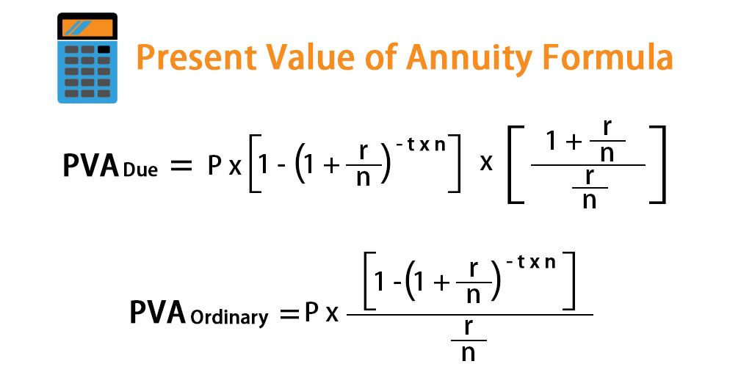
Present Value of an Ordinary Annuity
Description: Determines the present value of an ordinary annuity using payments, interest rate, and total periods provided by the user.
Formula:
Function:
pv_ordinary_annuity(pmt:float, rate:float, periods:float)-> float
Notes:
Jordan

Slide 9
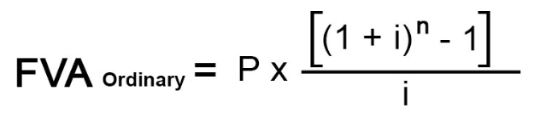
Future Value of an Ordinary Annuity
Description: Calculates the future value of an ordinary annuity based on payments, interest rate, and total periods entered by the user.
Formula:
Function:
fv_ordinary_annuity(pmt:float, rate:float, periods:float)->float
Notes:
Jordan

Slide 10
Present Value of an Annuity Due
Description: Computes the present value of an annuity due using payments, interest rate, and total periods specified by the user.
Formula:
Function:
pv_annuity_due(pmt:float, rate:float, periods:float)->float
Notes:
Jordan

Slide 11
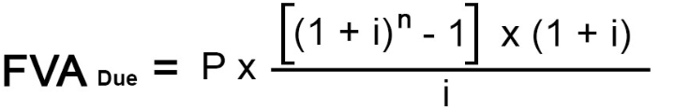
Future Value of an Annuity Due
Description: Determines the future value of an annuity due based on payments, interest rate, and total periods entered by the user.
Formula:
Function:
fv_annuity_due(pmt:float, rate:float, periods:float)->float
Notes:
Jordan

Slide 12

Present Value of a Growing Annuity
Description: Calculates the present value of a growing annuity using growth rate, payments, interest rate, and total periods.
Formula:
Function:
growing_annuity(initial_cash_flow:float, rate:float, growth_rate:float, periods:float)->float
Notes:
Vishal

Slide 13

Present Value of a Perpetuity
Description: Computes the present value of a perpetuity using the annual payment and discount rate.
Formula:
Function:
perpetuity(cash_flow:float, rate:float)->float
Notes:
Vishal

Slide 14

Present Value of a Growing Perpetuity
Description: Calculates the present value of a growing perpetuity based on growth rate and discount rate.
Formula:
Function:
growing_perpetuity(initial_cash_flow:float, rate:float, growth_rate:float)->float
Notes:
Vishal

Slide 15
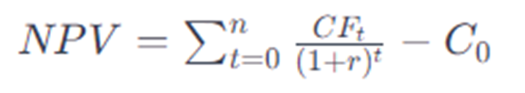
Cash Flow Analysis
Description: Performs cash flow analysis on potential investment projects
Formula:
Function:
cash_flow_analysis(initial_investment:float, cash_flows:List[float], discount_rate:float)->float
Notes:
Vishal

Slide 16
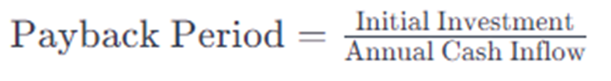
Payback Period
Description: Calculates the payback period using the initial investment and annual cash flow.
Formula:
Functions:
payback_period(initialInvestment:float, annualCashFlow:float)->float
Notes:
Anith

Slide 17
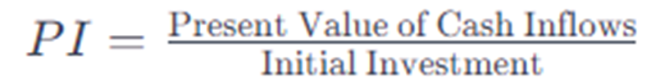
Probability Index
Description: Computes the probability index using initial investment, cash inflow, and discount rate.
Formula:
Function:
probability_index(initialInvestment:float,cashInFlow:List[float], discountRate:float)->float
Notes:
Anith

Slide 18

Loan Payments
Description: Computes periodic payments given a loan amount and time period.
Formula:
Function:
annuity_payment(principal:float, rate:float, periods:float)->float
Notes:
Angelina - or someone else if it flows better

Slide 19
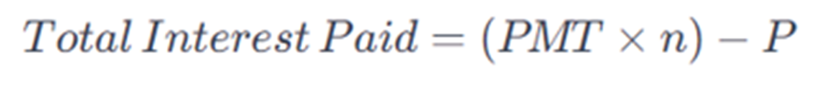
Total Interest Paid
Description: Determines the total interest paid using loan payment, new payment, and principal.
Formula:
Function:
total_interest_Paid(loan_payment:float, numPayments:float, principal:float)->float
Notes:
Anith

Slide 20
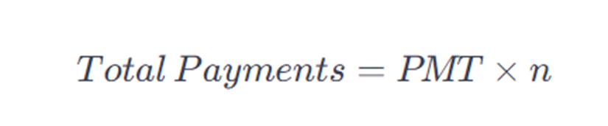
Total Payments
Description: Calculates total payments using loan payment and the number of payments.
Formula:
Function:
total_payments(loan_payment:float, numPayments:float)->float
Notes:
Anith

Slide 21
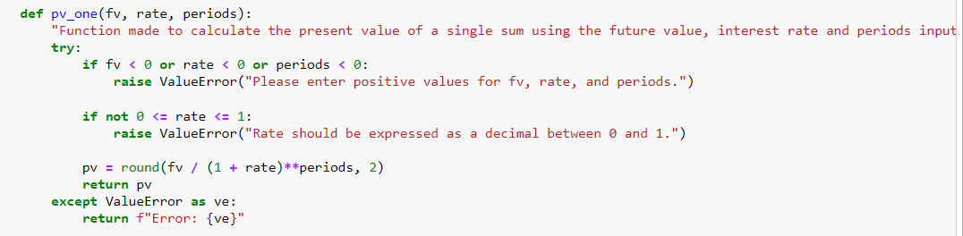
User Misinput Robustness
We used the try and except statements paired with if statements to ensure the user did not input incorrect values
Notes:
Jordan - This function for calculating the present value of a single annuity has a try except function to make sure the user inputs positive values for future value, rate and periods, as well as making sure the rate is a decimal between 0 and 1

Slide 22
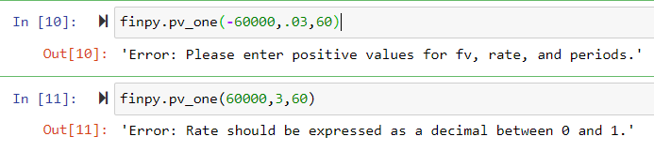
Try Except Results
Notes:
Jordan

Slide 23
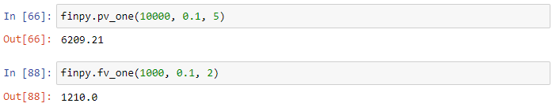
Application of Package
Example: In 5 years, you will have $10,000. If the value is compounded at a rate of 10%, the present value is:
Example: You plan to invest $1,000 at a rate of 10%. In 2 years, the investment will be worth:
Notes:
Angelina

Slide 24
Application of Package
Example: A cash flow of $30,000 will be received in perpetuity, to be compounded a rate of 8%.
Example: If you invest $1,000 today, you will receive three annual payments of $500. With an interest rate of 10%, the NPV is:
Notes:
Angelina

Slide 25
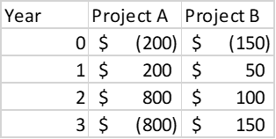
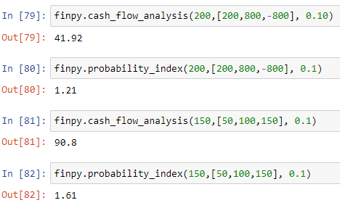
Application of Package: Comparing Projects
Given the two projects above, the functions can be used to compute values that can be compared to choose the more profitable investment.
Notes:
Angelina

Slide 26
Individual Contributions
Jordan Braycewski: created pv_one, pv_ordinary_annuity, pv_annuity_due, fv_one, fv_ordinary_annuity, fv_annuity_due functions for the project, as well as helped complete part of the presentation and the report.
Vishal Sukumar: Created perpetuity, growing_perpetuity, and NPV cash_flow_analysis functions for the project and worked on completing the report
Angelina Rabbia: created annuity_payment function, compiled functions into package, wrote documentation for the project
Anith Joy: Created payback_period, probability_index, total_interest_paid, total_payments functions for the project, and helped to complete some parts of the presentation.
Notes:
Angelina

